Slide 1
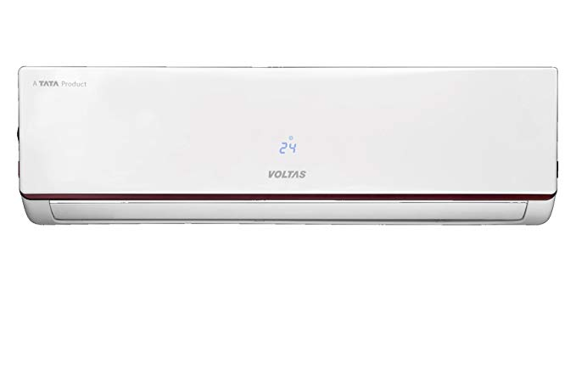
VOLTAS AC REPAIR AND SERVICE CENTER

Slide 2
VOLTAS AC
Voltas is one of the promising AC producers in India. Being the Indian brand it offers best AC suiting for Indian conditions and spending plan. Despite the fact that Volta’s is an Indian brand it doesn't miss the mark in innovation, it accompanies a heap of highlights.
The Korean Electronics significant like Samsung and LG are in direct rivalry with Voltas. Voltas new lineup of AC models matches with the worldwide measures as do the Samsung, LG offer. With regards to highlights Voltas ACs has the high ground and the better cooling limit with less vitality utilization.
There is no uncertainty that Voltas is one of the quickest developing AC marks in India and can discover Voltas AC benefit focus all the place.

Slide 3
AC REPAIR AND SERVICE CENTER AT HOME SERVICE
Do you claim Volta's forced air system? Searching for the Voltas AC Service Center? Your inquiry has been made simple by At Home Service. Discover the Voltas AC Service Center close you with no issue.
At Home Service has thought of an easy to use stage and give you doorstep AC fix benefit. With the assistance of At Home Service home administrations, you can procure a trusted and qualified professional for AC benefit at your doorstep. You don't need to venture out of the home looking for Voltas AC benefit focus any longer.

Slide 4
WHY AT HOME SERVICE?
Well prepared professionals.
A bother free Service
Best Quality Work at Low Cost.
Give 100% agreeable work.
Using Best Quality tools.
Handyman can't leave work in mid or fragmented.
Having B-tech Engineer's Team
Work completion in promised Time.
Deals in little and all real work on visiting and contract premise.
Just Call and Get Solution
Get professional and Expert Technician

Slide 5
WHY AT HOME SERVICE?
No concealed expense
Reasonable Cost
15 days warranty
Call for little or Major work
On time response
Expert consultant Team
24 hours benefit 7 days
Can complaints
Provides all home maintenance solution in single ROOF.

Slide 6
CONCLUSION
At Home Service mission is to give learned, advantageous, and sensible evaluated Handyman Service to the World. At Home Service want to make a deep rooted association with our client and dependably gives the best service. At Home Service is the organization that maintains a one of a kind and imaginative thought in his business, we are utilizing the best quality apparatuses from which we can without much of a stretch complete the work effortlessly with quality. At Home Service is running with this expect to give the best services to our customer and make it EASY.

Slide 7
CONTACT US
Call: +91-7708110225 | 0422-4270002
No,1G, Kannusamy Layout, Bypass Road, Near Pudupalam, Sivananda Colony, Coimbatore 641012

